Slide 1

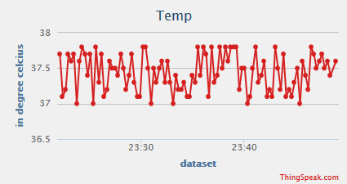
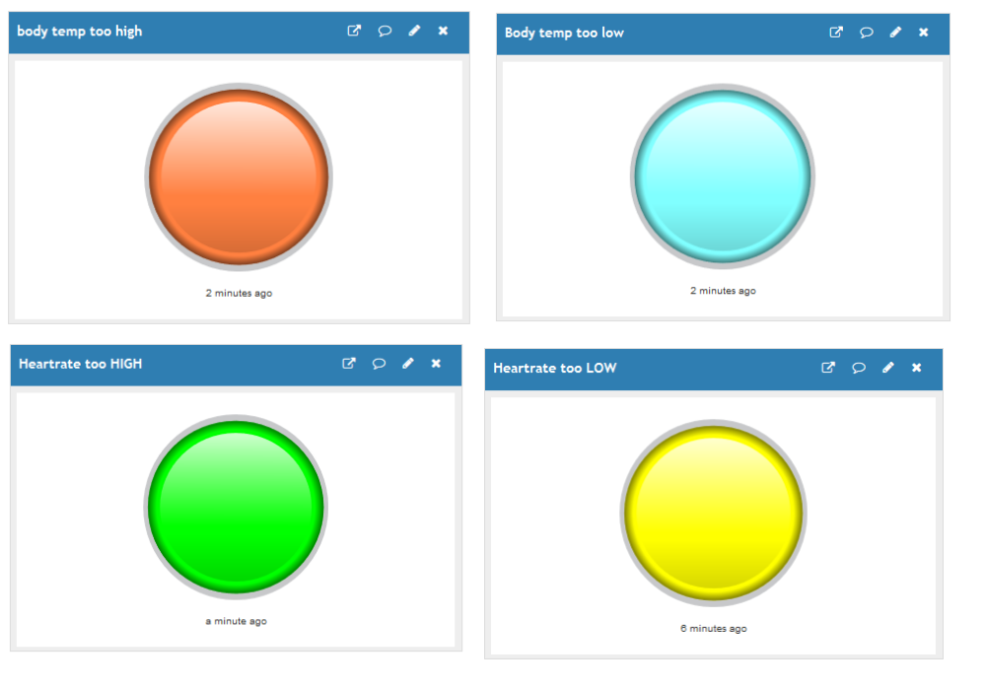
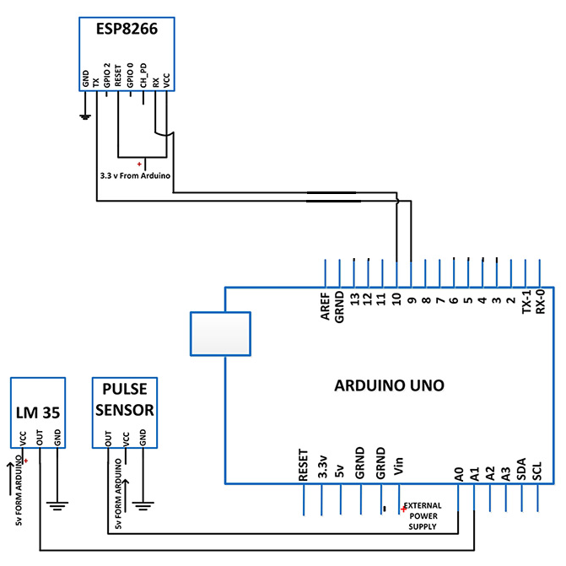
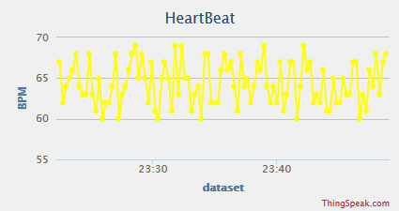
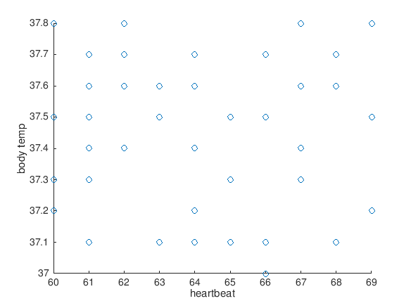
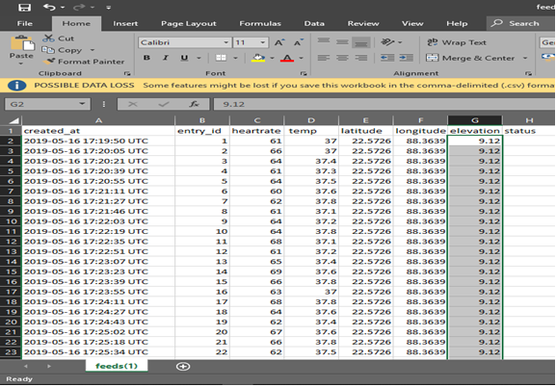
IOT BASED HEALTH MONITORING SYSTEM
Department of Electronics And Communication Engineering
INSTITUTE OF ENGINEERING & MANAGEMENT
CHANDAN SINGH , RISHU RAJ
Prof. Sutapa Ray Adhikary
Introduction
Internet of Things is the fastest growing technology. IoT is about to find application everywhere and in everything. Medical Electronics is also going to advance with the application of Internet of Things. Nowadays Health-care Environment has developed science and knowledge based on Wireless-Sensing node Technology oriented. Patients are facing a problematic situation of unforeseen demise due to the specific reason of cardiac attack which is because of non-existence of good medical maintenance to patients at the needed time. This an innovative project to dodge such sudden death rates by using Patient Health Monitoring that uses sensor technology and uses internet to communicate to the loved ones in case of problems. This system uses Temperature and heartbeat sensor for tracking patient’s health. Both the sensors are connected to the Arduino Uno. To track the patient health micro-controller is interfaced to a wi-fi connection to send the data to the web-server.
Method
CIRCUIT CONNECTION
Results
Alerts
Display of Body temperature
Display of Heartrate
Data collection and storage
To measure temperature the host just has to put their finger on the temperature sensor and the sensor will gradually adapt with the hosts temperature and take that data in the Arduino.
To measure the pulse of the host, they simply have to put their finger on the green light and the sensor will automatically send the pulse per minute data to the Arduino.
Thingspeak, a website that allows storing data and analysis them is used. The ESP-8266 is used for connecting the Arduino with the internet and stores that necessary data’s to Thingspeak server. The ESP-8266 will receive data’s from the Arduino and with the help of a Wi-Fi connection, the ESP-8266 will send the acquired data’s to Thingspeak server
Conclusion
Our main objective in this project was to successfully monitor the basic criteria’s namely temperature, pulse and react during emergency situation without any human interaction. With the rise of IoT, the era of technology is moving towards a far superior dimension. In order to keep pace with the new technologies, this project can sure make way for the advancement in this sector. The real benefit of this work can only be fully realized when it can be implemented in full scale.
Heartrate V/S Temp
Aim
Recording the patient heart beat rate and body temperature.
Sending the readings to the ThingSpeak server.
Remote monitoring by healthcare specialist.
Alert generation.
References
[1] H.N. Saha; S.Auddy; S. Pal. Health monitoring using Internet of Things (IoT) by 2017 8th Annual Industrial Automation and Electromechanical Engineering Conference (IEMECON)
[2] Brock, D. L. (2001). The electronic product code (epc). Auto-ID Center White Paper MIT-AUTOID-WH-002.
[3] Ni, Q., García Hernando, A. B., & de la Cruz, I. P. (2015). The elderly’s independent living in smart homes. Sensors, 15(5), 11312-11362
Data analysis and alert
The manipulation of data is one of the features of Thingspeak. User can analyze the data according to the need using the MATLAB.
Another important feature of Thingspeak is it provides a react option to its users. The react option helps to give an instant reaction to the concerning authority whenever a definite condition is fulfilled.
EXPORTED DATA
Acknowledgements
Prof. Sutapa Ray Adhikary, Assistant Professor, E.C.E.
Prof. Dr. Malay Gangopadhyay, Head of Department E.C.E
Prof. A. K. Nayak, Principal, I.E.M
Prof. Dr. Satyajit Chakraborty, Director, I.E.M.

